Slide 1
Nonlinear Systems Analysis
2-dimensional nonlinear analysis
Limit cycles and oscillators
Notes:
Bioen485 Computational Bioengineering
10/28/2004
Stability of (non)linear systems; Tools in Phase-Plane; Deterministic chaotic systems
POINTS:
Identify types of protein regulation – small molecule, protein, covalent
Identify chemical basis of regulation – allosteric, direct, location
Identify how genes are regulated – protein repressors and activators
Networks are complex, modular, robust, and noisy
ODEs won’t suffice in many cases.

Slide 2
Nonlinear Systems
May have multiple equilibrium points
Must consider stability of each equilibrium point
  Rather than stability of whole system.
But, methods have some similarity with linear systems.
(Will continue with these next week.)

Slide 3
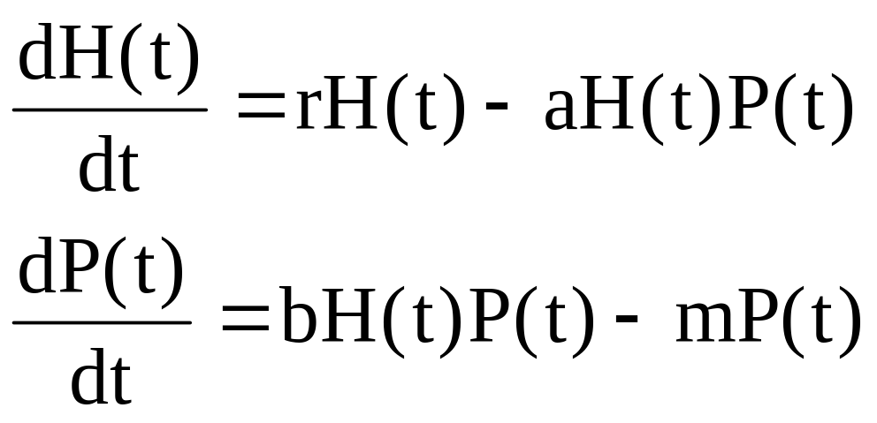
EXAMPLE 1 of Nonlinear System:
Lotka Volterra Predator-Prey Model:

Slide 4
METHOD: Phase Plane Analysis
If a system has two state variables, x and y:
Graph x vs y instead of x vs t and y vs t
Allows:
  Plotting nullclines
  Plotting trajectory in phase plane for a set of initial conditions (a trajectory is the way a system changes over time).

Slide 5
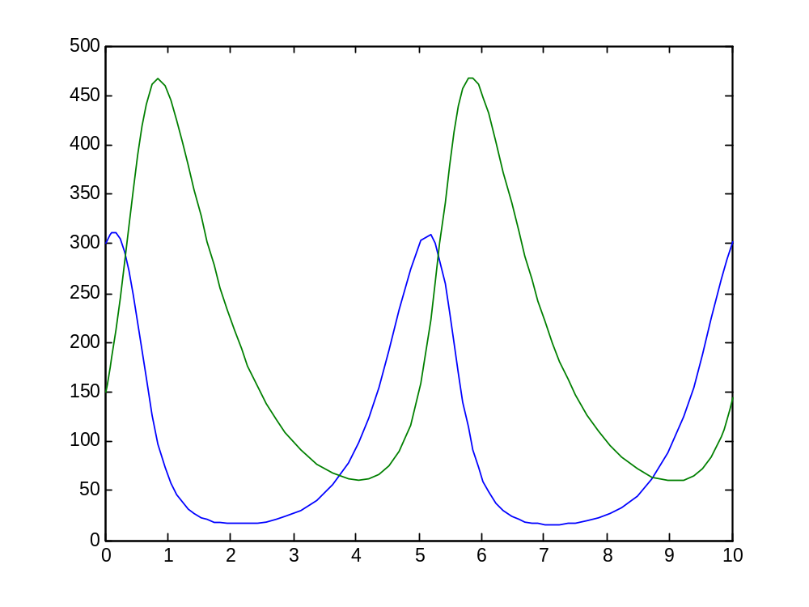
Prediction Over Time
Predator P(t)
r = 2
a = 0.01
b = 0.01
m = 1
H(0) = 300
P(0) = 150
Prey H(t)

Slide 6
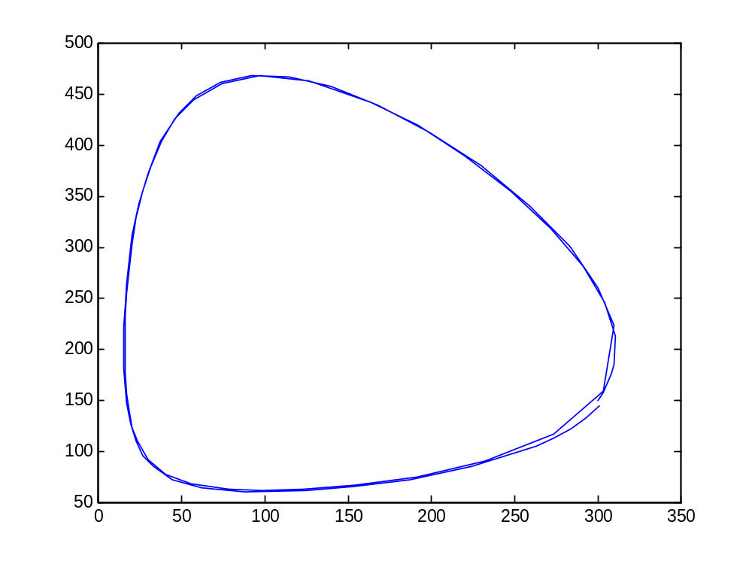
Phase-Plane Trajectory:
Lotka-Volterra system same parameters and initial conditions as before
Predator P(t)
Prey H(t)

Slide 7
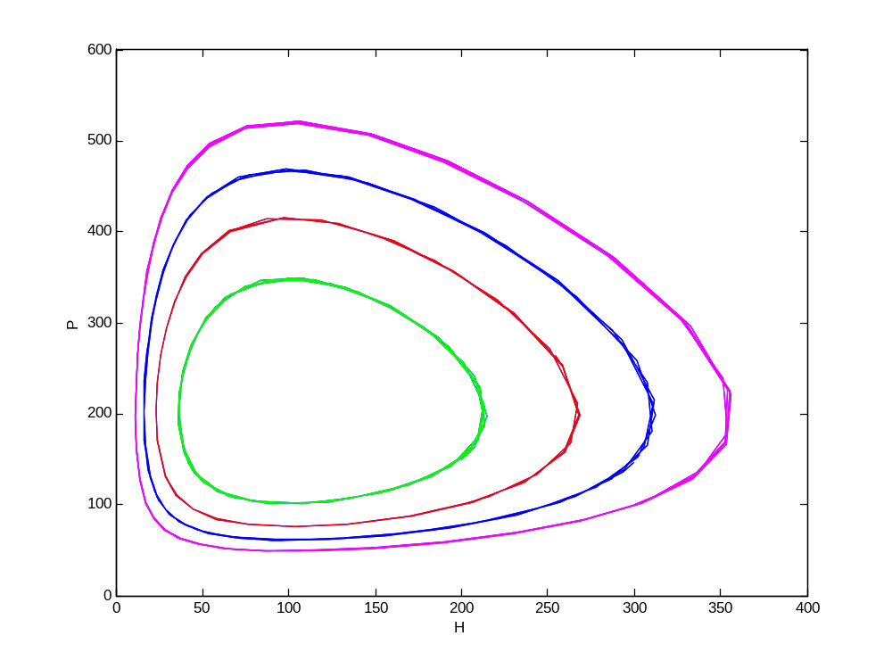
Lotka Volterra: Different ICs
Different starting conditions give different oscillating patterns

Slide 8
METHOD: Steady State Analysis for Nonlinear Systems
Steady state is where all derivatives are zero
Solve by setting all state derivatives to zero (nullclines)
  N differential equations becomes
  N algebraic equations in N unknowns.
The intersection(s) of the nullclines are equilibrium points.
Also called singular points:
  In the phase plane, dy/dt = 0 and dx/dt = 0 means that dy/dx is singlular.

Slide 9
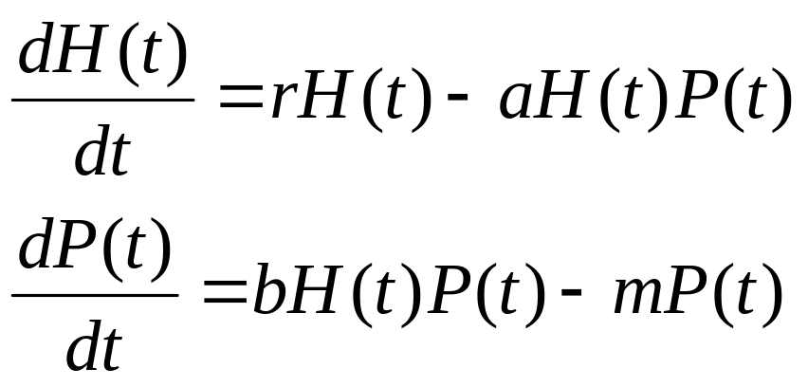
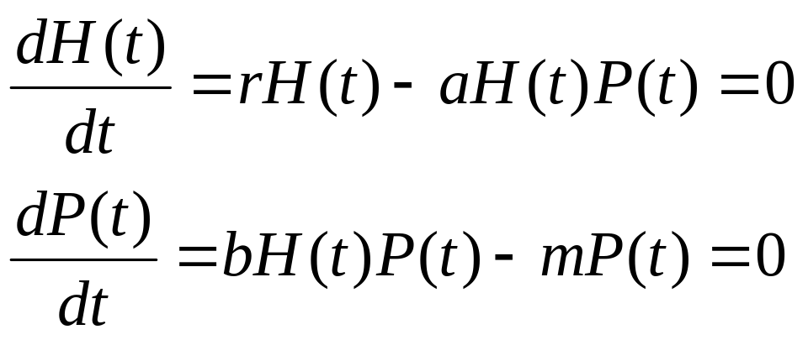
Steady-State Analysis Example:
Lotka Volterra Model
The equilibrium points are the solutions of

Slide 10
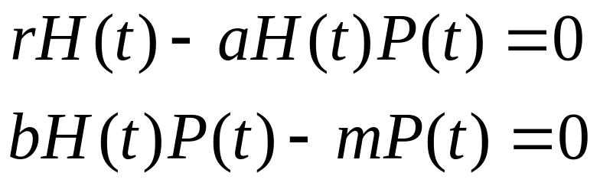
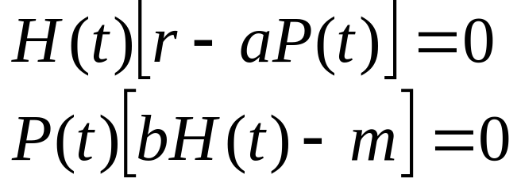
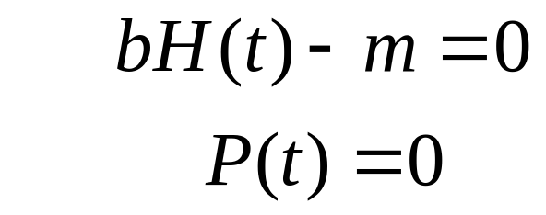
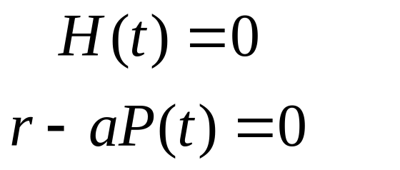
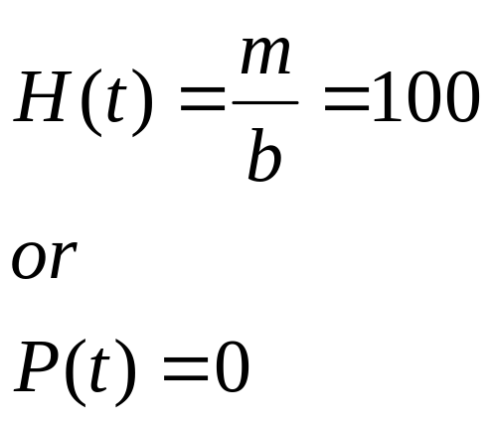
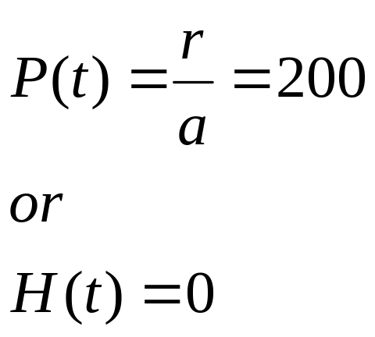
Find the Nullclines:
(for r=2, a=0.01, b=0.01 and m=1)
Two nullclines for each equation
AND
AND

Slide 11
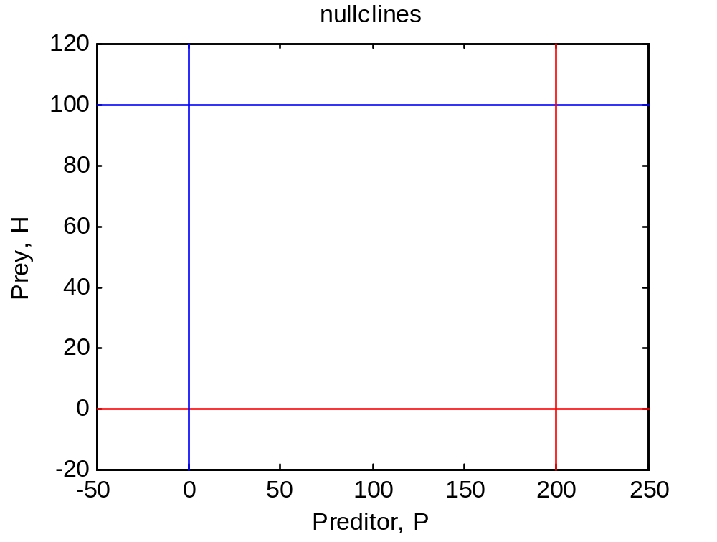
Graph the Nullclines:
blue lines: dP/dt = 0
red lines: dH/dt = 0
Anywhere a red meets a blue is an equilibrium point.

Slide 12
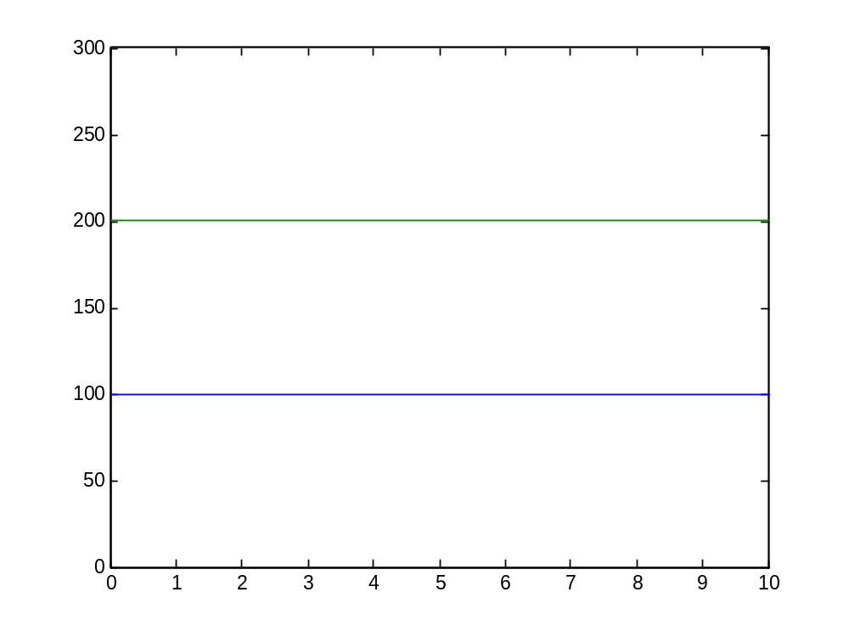
Dynamic Behavior of
System Starting at Equilibrium
Systems starting at equilibrium do not change

Slide 13
METHOD: Steady State Stability
What if system is perturbed by amount
How does the system respond?
  Does it return to original point? (stable)
  Does it maintain perturbation? (marginally stable)
  Does it amplify perturbation? (unstable)
  Does it maintain an oscillation?
  Does it oscillate while returning to equilibrium?

Slide 14
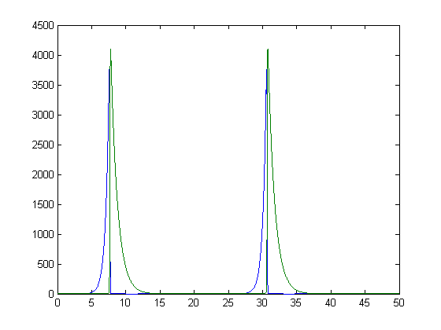
Lotka Volterra Behavior near (0,0)
r = 2
a = 0.01
b = 0.01
m = 1
H(0) = 0.001
P(0) = 0.001
P, H
Time

Slide 15
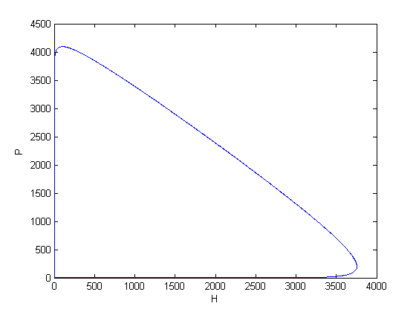
Lotka Volterra Behavior near (0,0)
Saddle point:
From one direction, approaches (0,0)
From another direction, leaves (0,0)
r = 2
a = 0.01
b = 0.01
m = 1
H(0) = 0.001
P(0) = 0.001
P
(0,0)
H

Slide 16
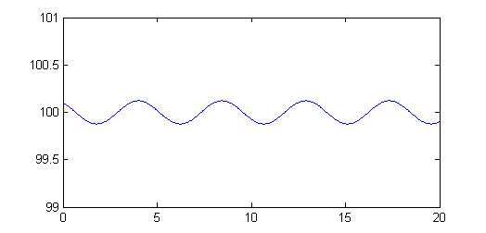
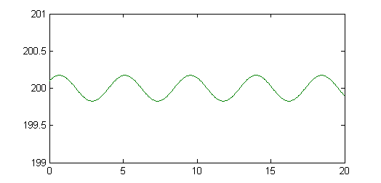
Lotka Volterra Stability near
(H₀,P₀) = (m/b,r/a) =(100,200)
H
r = 2
a = 0.01
b = 0.01
m = 1
H(0) = 100.1
P(0) = 200.1
P
Time

Slide 17
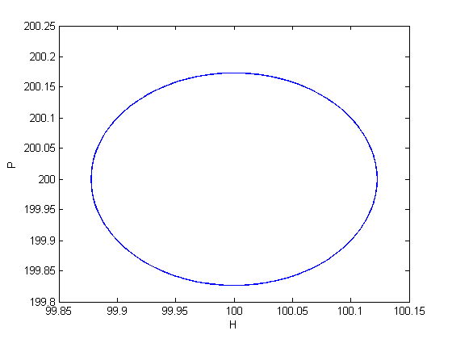
Lotka Volterra Stability near (100,200)
r = 2
a = 0.01
b = 0.01
m = 1
H(0) = 100.1
P(0) =200.1
P
100,200
H
Neutrally (marginally, bounded) stable center:
Neither leaves nor approaches the singular point (100,200);
Oscillatory center: Instead, oscillates around it

Slide 18
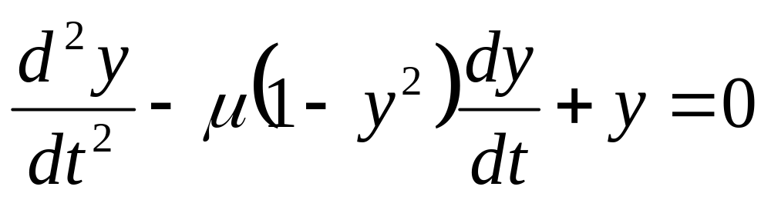
EXAMPLE 2 of Nonlinear System:
Van der Pol Equation
Model for dynamic oscillations in the heart (1928)

Slide 19
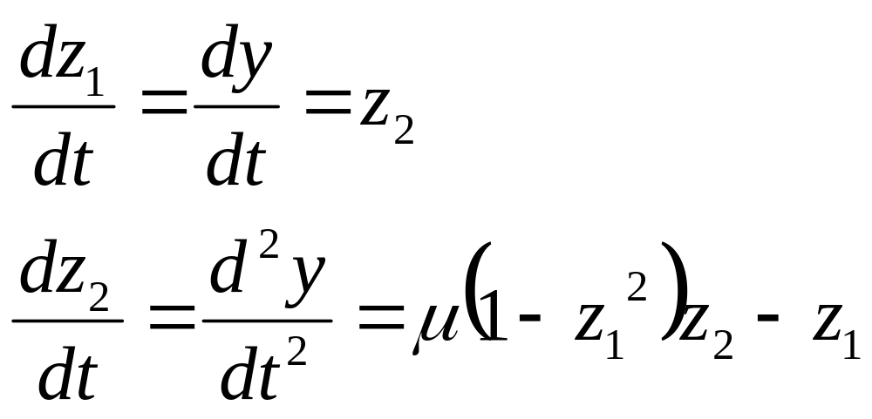
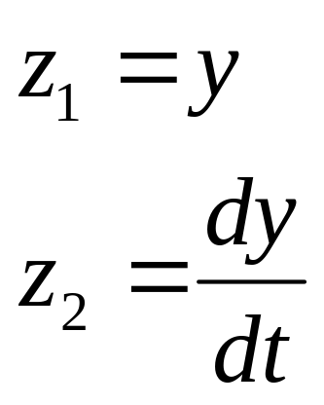
State-Space of Van der Pol Equation
This is second order nonlinear in y.
Convert to State space representation:
Now system is coupled set of first order nonlinear

Slide 20
Van der Pol code
function y = vanderPol(mu,y0,dy0,tmin,tmax)
tspan = [tmin;tmax];
y0 = [y0; dy0];
options=[10e-9];
[t,y] = ode23s(@vdpODE,tspan,y0,options,mu);
y(:,3) = t;
return;
function dydt = vdpODE(t,y,mu)
dydt(1,1) = y(2);
dydt(2,1) = mu*(1-y(1)^2)*y(2)-y(1);

Slide 21
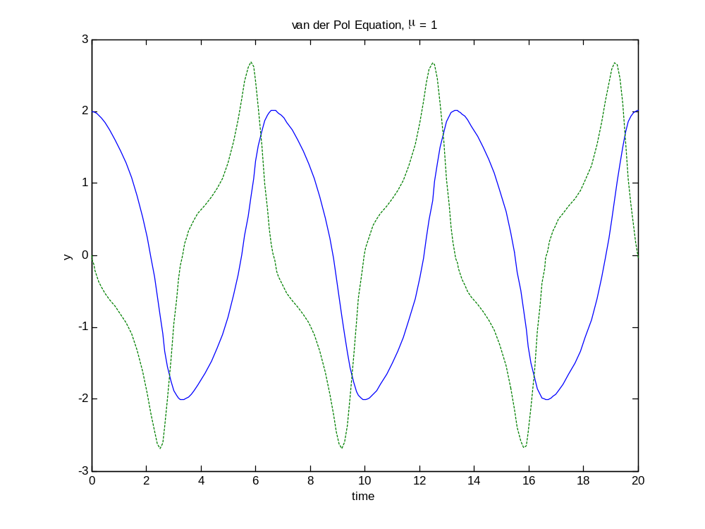
Van der Pol Equation:
Time Trajectory
y
mu = 1
y(0) = 2
dy/dt(0) = 0
dy/dt
time
Like lotka-volterra, oscillates with time

Slide 22
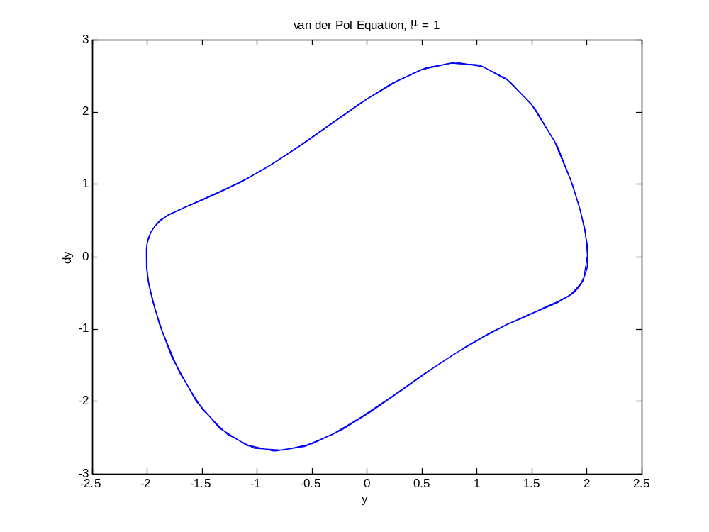
Van der Pol Equation:
Phase Plane
dy/dt
y
Like lotka-volterra, closed loop in phase plane

Slide 23
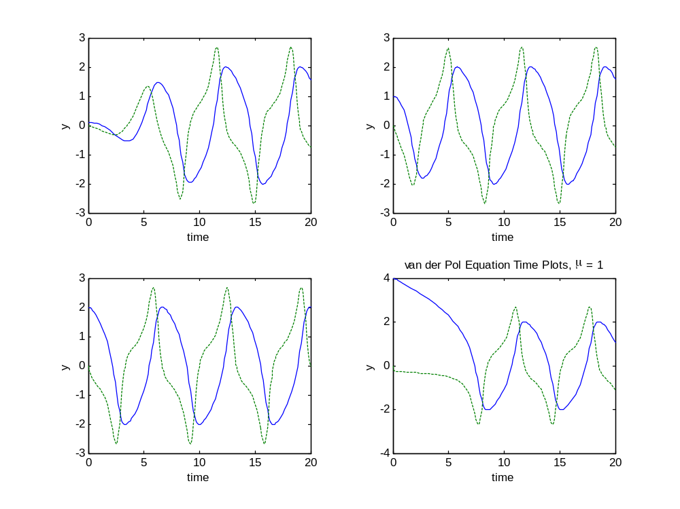
Van der Pol Equation:
Effect of different initial conditions
y(0) = 0.1
y(0) = 1
y(0) = 2
y(0) = 4
Always settles to the same behavior!

Slide 24
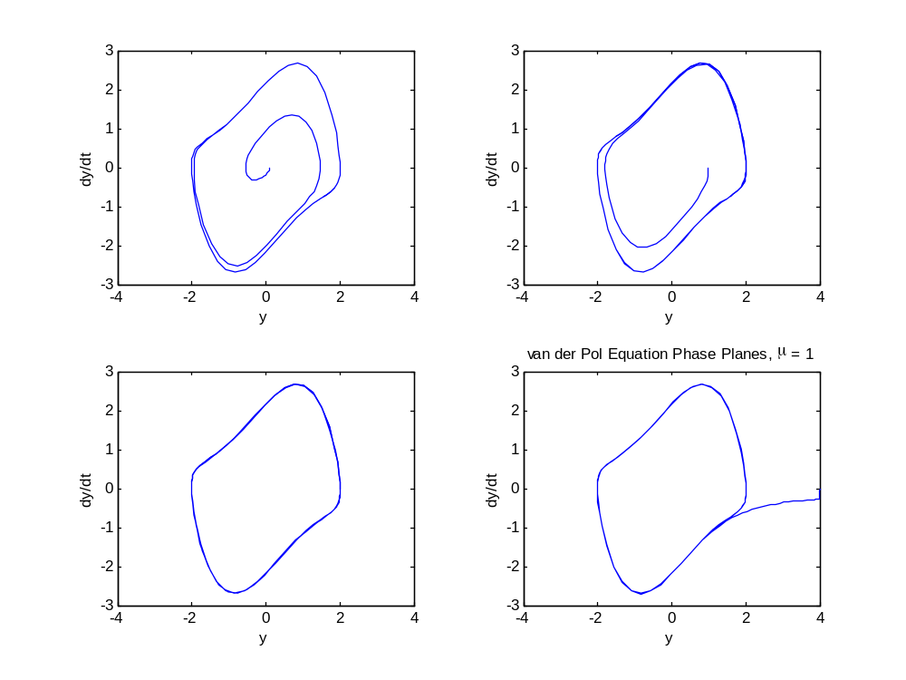
Van der Pol Equation:
Effect of different initial conditions
y(0) = 0.1
y(0) = 1
y(0) = 2
y(0) = 4
Always settles to the same closed loop, or Limit Cycle

Slide 25
Limit Cycles
Some systems tend towards a stable limit cycle
Over a wide range of initial conditions, they will reach the same oscillatory pattern.
In the phase plane, a limit cycle is a closed loop.
Off-loop initial conditions spiral or converge onto limit cycle
What is the advantage of a stable limit cycle to biology?
Why won’t you identify a stable limit cycle with equilibrium analysis?
How can you identify a stable limit cycle?

Slide 26
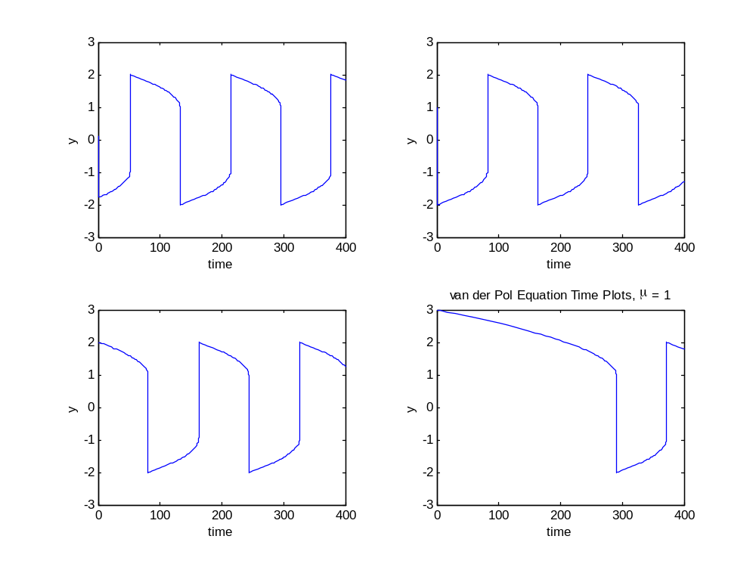
Van der Pol with μ = 100
Note: need to solve using stiff ODE solver!

Slide 27
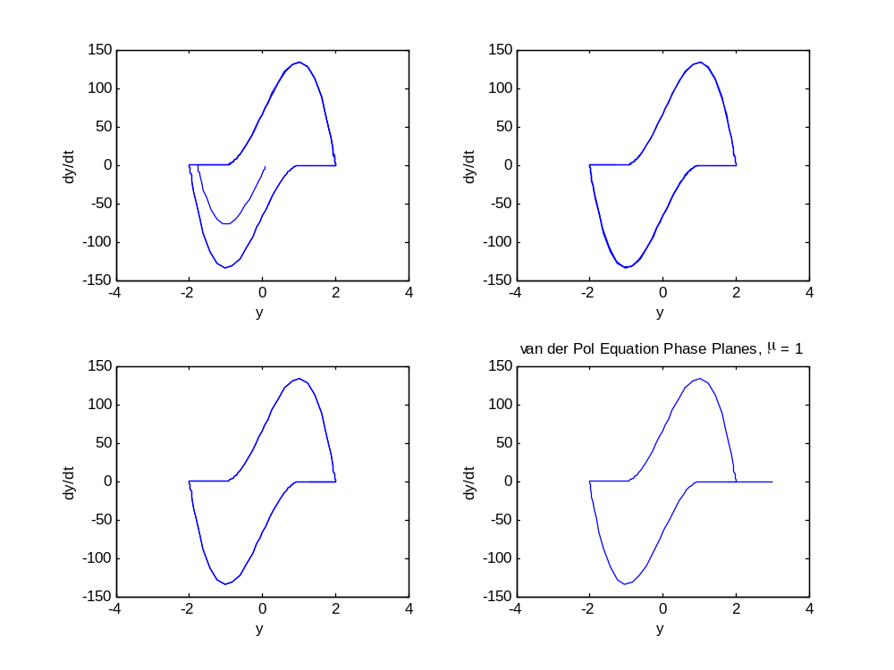
Van der Pol with μ = 100

Slide 28
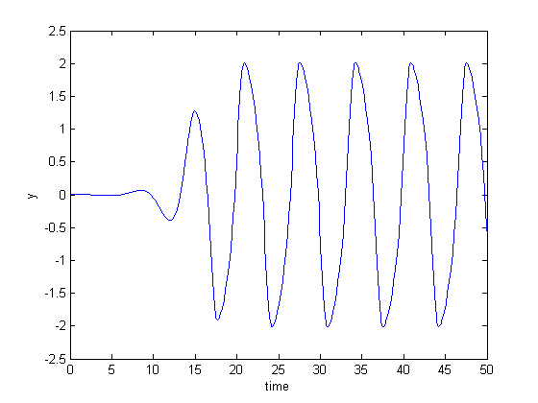
van der Pol Stability at (0,0), μ<2
μ = 1
y(0) = 0.001
dy(0) = 0.001
y
Time
If μ<2, roots are complex with positive real component;
(0,0) is an unstable focus
solution oscillates away from (0,0)

Slide 29
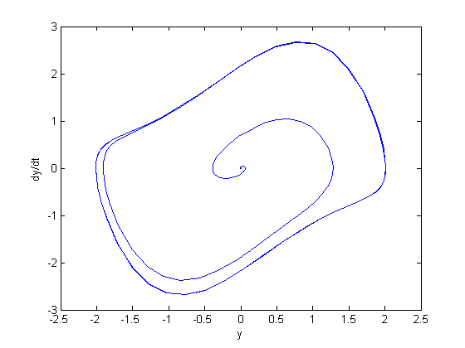
van der Pol Stability at (0,0), μ< 2
μ = 1
y(0) = 0.001
dy(0) = 0.001
dy/dt
y
Spirals out of unstable focus, into limit cycle.

Slide 30
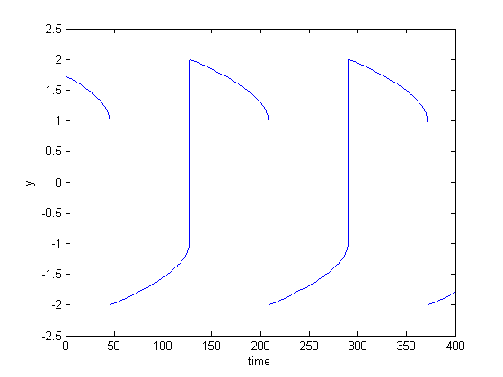
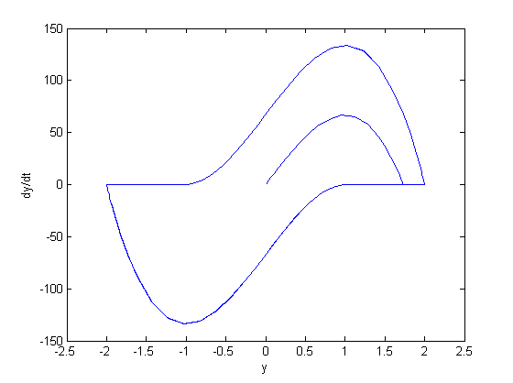
van der Pol Stability at (0,0), μ ≥ 2
μ = 100
y(0) = 0.001
dy(0) = 0.001
y
dy/dt
Time
y
If μ ≥ 2, both roots are real positive
(0,0) is an unstable node; solution shoots away from (0,0)
Still approaches stable limit cycle.

Slide 31
Equilibrium Points and Limit Cycles
In the van der Pol equation, (0,0) is an unstable singular point for all values of μ.
While (0,0) will remain at (0,0), all other values converge to the stable limit cycle.
This limit cycle is NOT identified when looking for equilibrium points, because the system is never in equilibrium on the limit cycle.
However, it is quickly identified as terminal behavior of a range of inputs.

